Slide 1

Predicting Whether a Bank Client Will Subscribe For a Term Deposit
09/23/2022

Slide 2

Objectives and Approach
Problem Description/Objectives : ABC Bank wants to sell its term deposit product to customers and before launching the product they want to develop a model which helps them in understanding whether a particular customer will buy their product or not (based on customer's past interaction with bank or other Financial Institution).
Approach: To predict whether a customer will subscribe for a term deposit, we will use the following techniques:
Exploratory Data Analysis
Logistic Regression
Machine Learning Methods
Ensemble (Random Forest)
Deep Learning (Artificial Neural Network)

Slide 3
Data
Target Variable: The target variable that we are trying to predict is ‘y’, which takes a value of 1 if a customer subscribes for a term deposit and 0 if they do not subscribe.
Features: There are a total of 16 features
7 Numerical features (age, balance, etc.)
9 Categorical features (job, marital status, etc.)

Slide 4
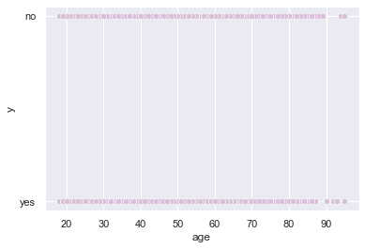
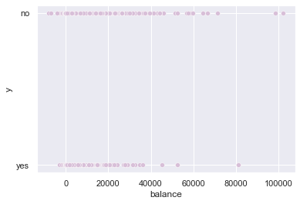
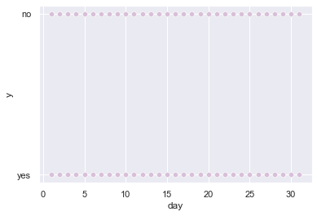
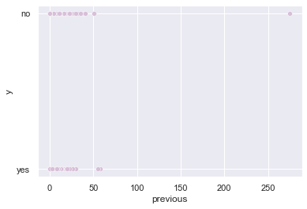
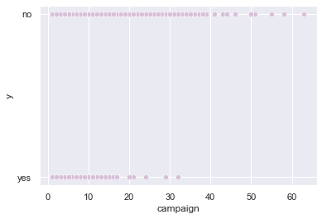
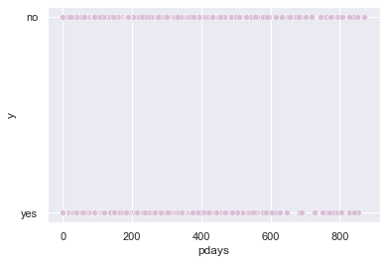
Identifying Outliers and Skewness

Slide 5
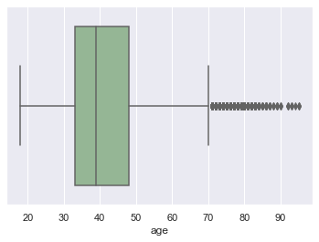
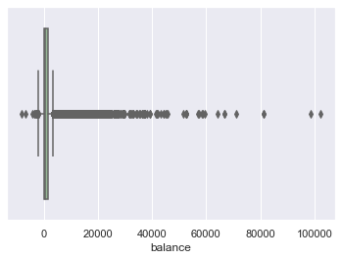
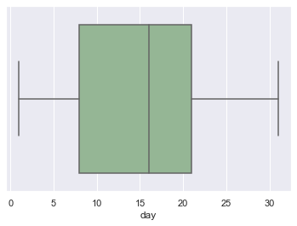
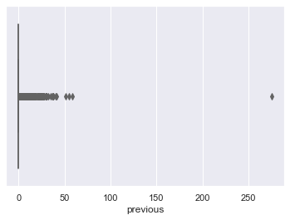
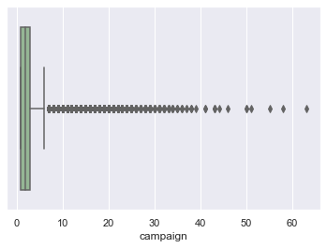
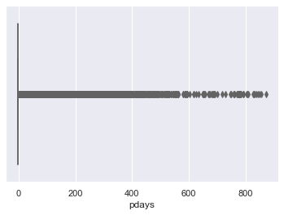
Identifying Outliers and Skewness Cont.

Slide 6
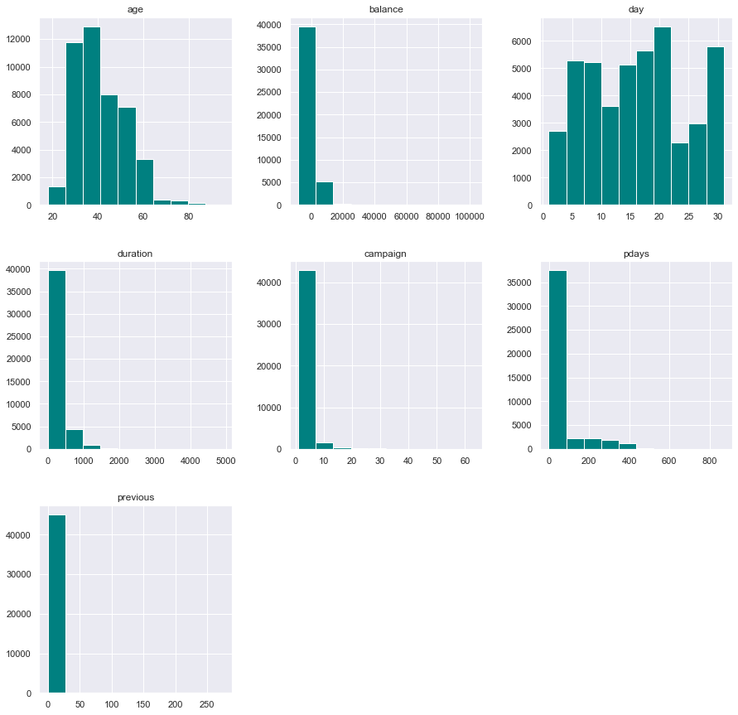
Identifying Outliers and Skewness Cont.

Slide 7
Potential Problems with the Data
Missing Values: In both of our datasets, we did not find any missing or NA values, so there was no need to deal with missing values.
Outliers: Most numeric variables in the dataset contained many outliers.
Skewness: Many of the numeric variables in the dataset were skewed, including ‘pdays’, ‘duration’, ‘campaign’, ‘previous’, and ‘balance’.

Slide 8
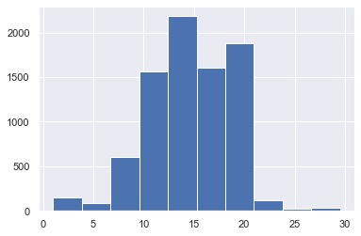
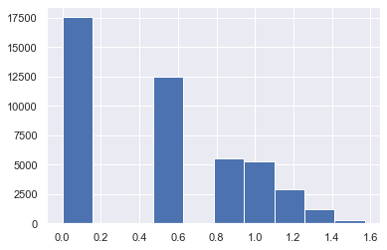
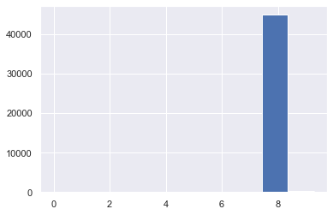
Data Cleaning
Pdays
Campaign
Balance
To deal with skewness in the ‘pdays’ variable, we performed a square-root transformation on the data. The data now appears much less skewed.
To deal with skewness in the ‘campaign’ and ‘balance’ variables, we used the Box-Cox method. The data now appears to be slightly less skewed.

Slide 9
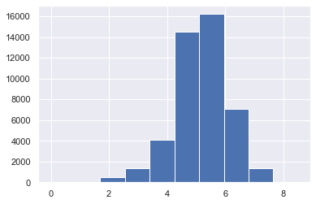
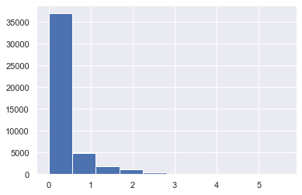
Data Cleaning
Duration
Previous
To deal with skewness in the ‘duration’ and ‘previous’ variables, we applied a log transformation to the data. The data now appears to be less skewed.

Slide 10
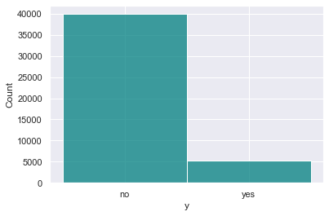
Exploratory Data Analysis
After looking at the scatterplots and box plots of the data, we examined the distributions of the target variable (above), and the feature variables (to the right) using histograms. The target variable appears to be unbalanced, with most clients choosing not to subscribe for a term deposit and very few clients choosing to subscribe for a term deposit. Note that the histograms of the feature variables were constructed before transforming the data.

Slide 11
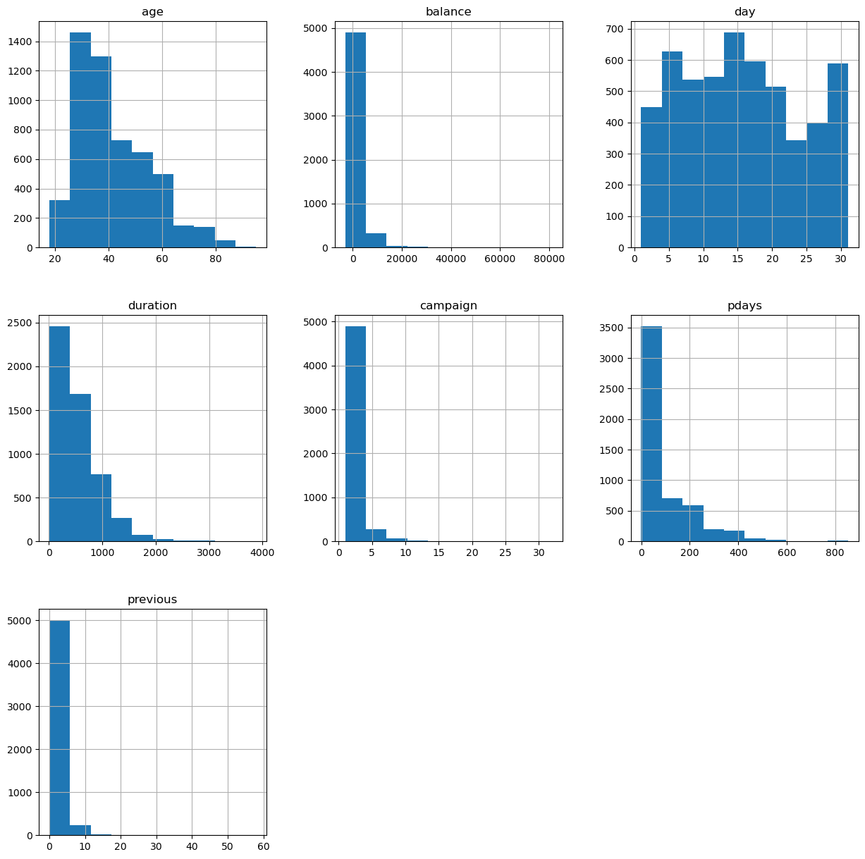
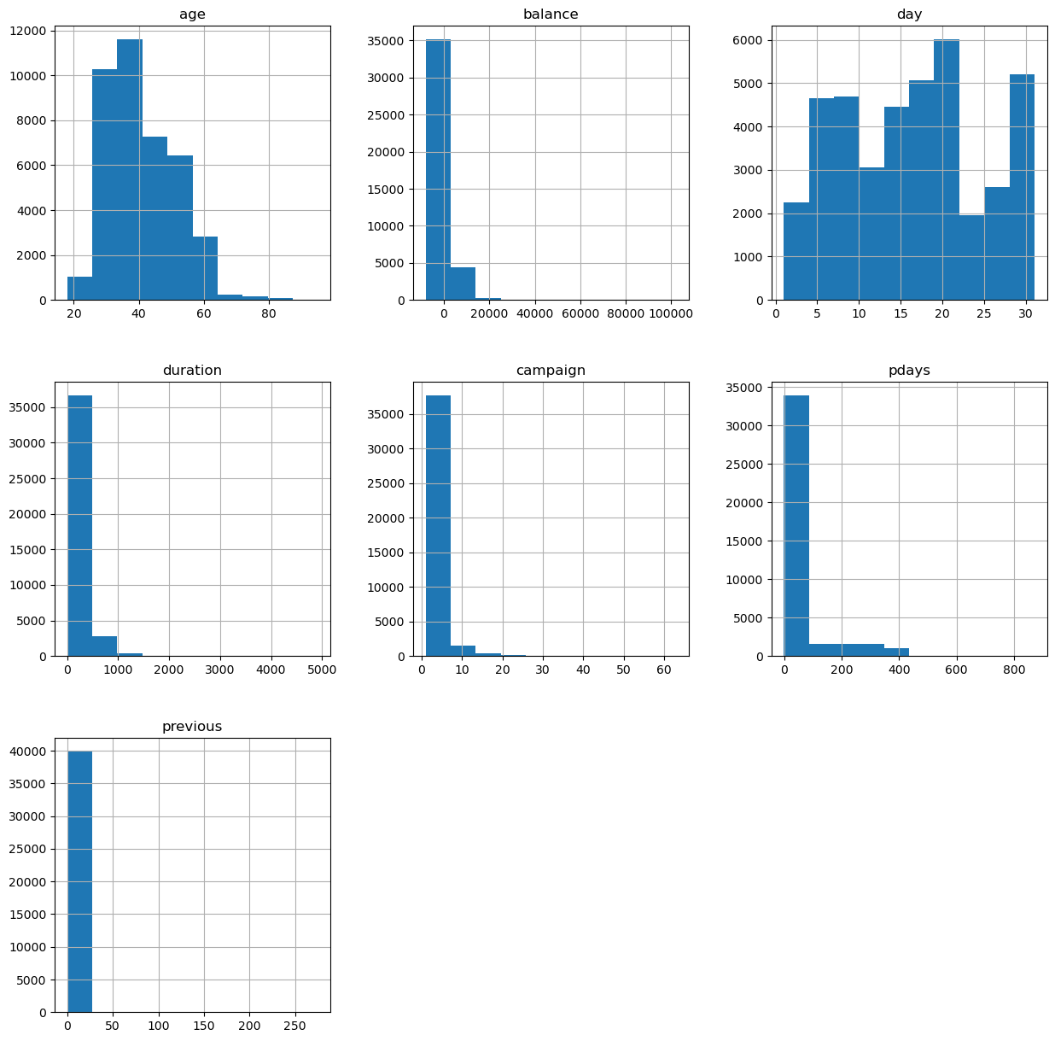
Exploratory Data Analysis
Clients Who Subscribed for a Term Deposit
Clients Who Did Not Subscribe for a Term Deposit

Slide 12
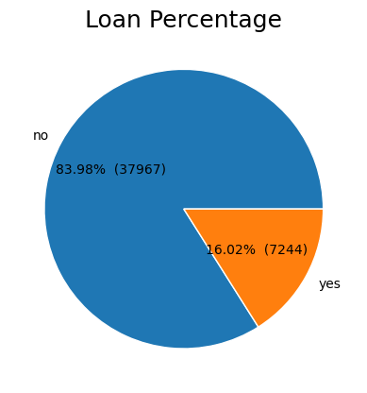
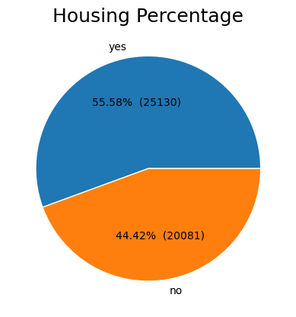
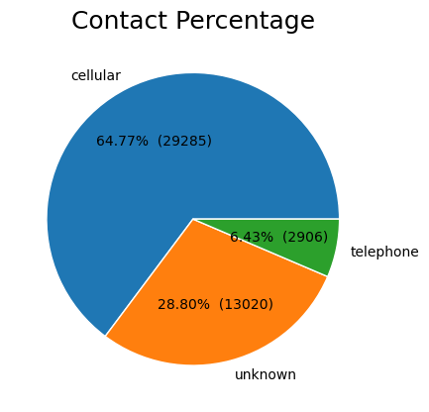
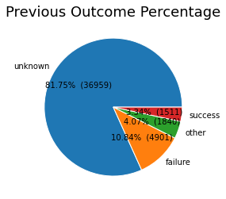
Exploratory Data Analysis

Slide 13
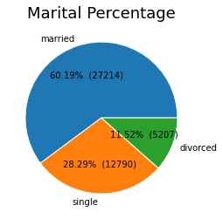
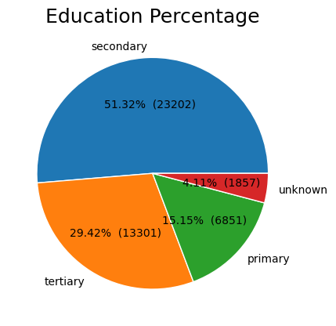
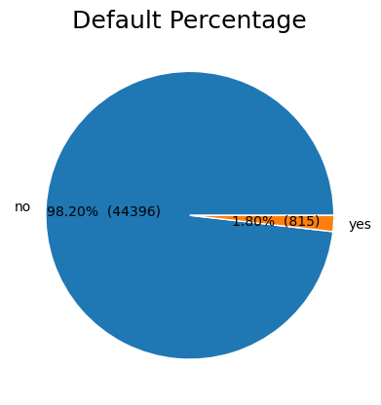
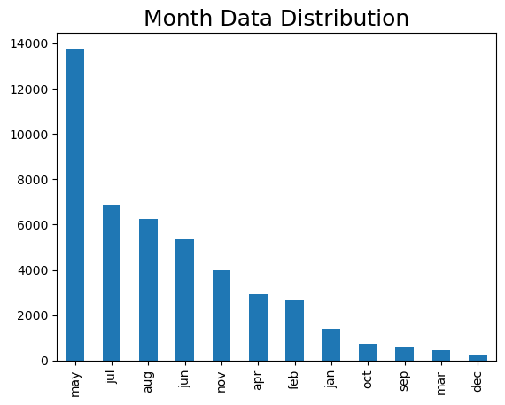
Exploratory Data Analysis

Slide 14
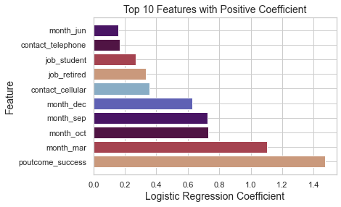
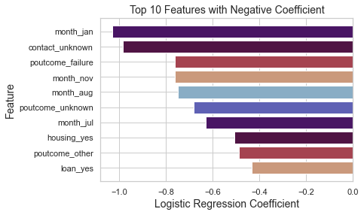
Logistic Regression Model

Slide 15
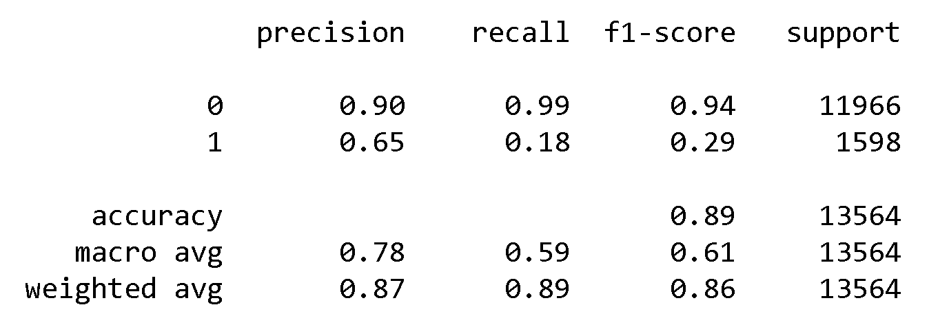
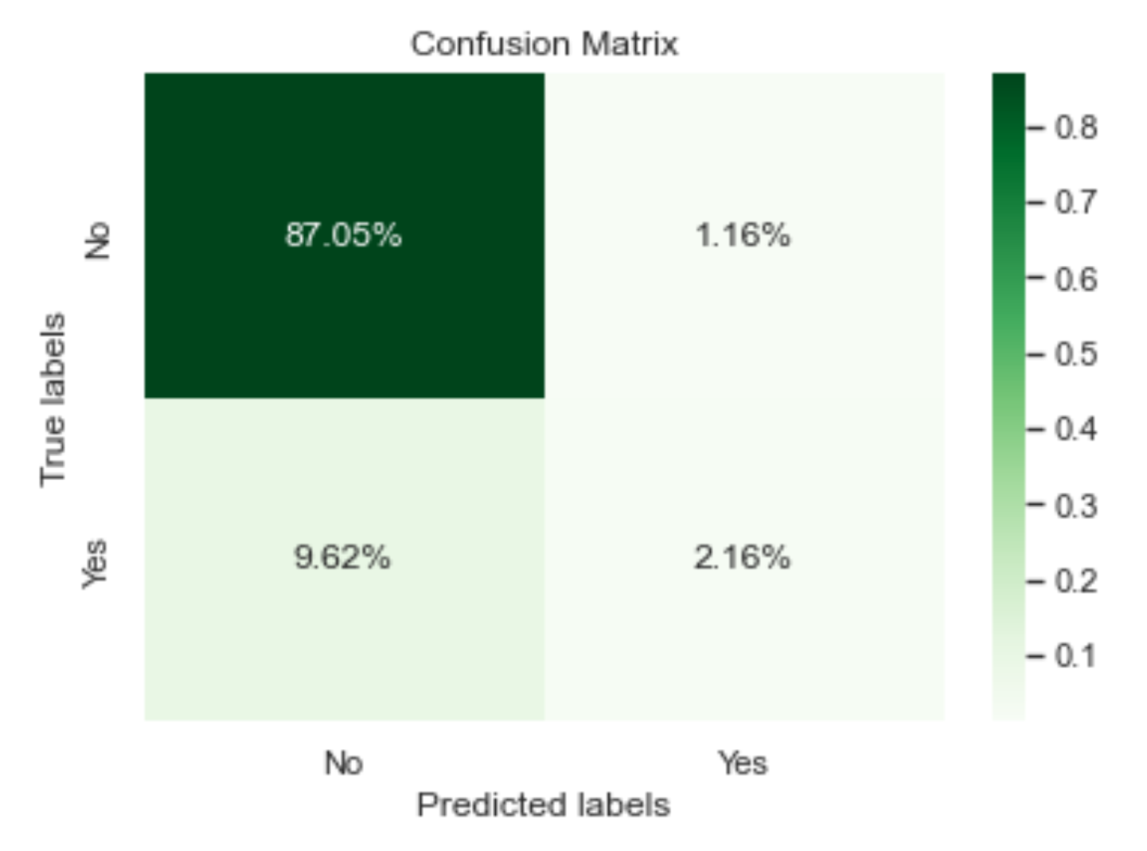
Logistic Regression Model
There are very few false positives (predicted value was ‘Yes’, but actual value was ‘No’), but many false negatives (predicted value was ‘No’, when the actual value was ‘Yes’). The model was very accurate at predicting ‘No’, but performed poorly when it came to predicting ‘Yes’.

Slide 16
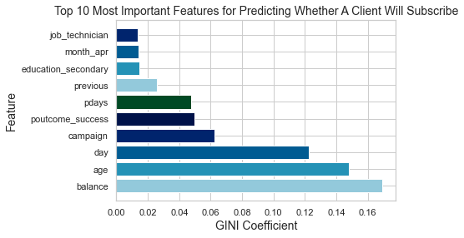
Random Forest

Slide 17
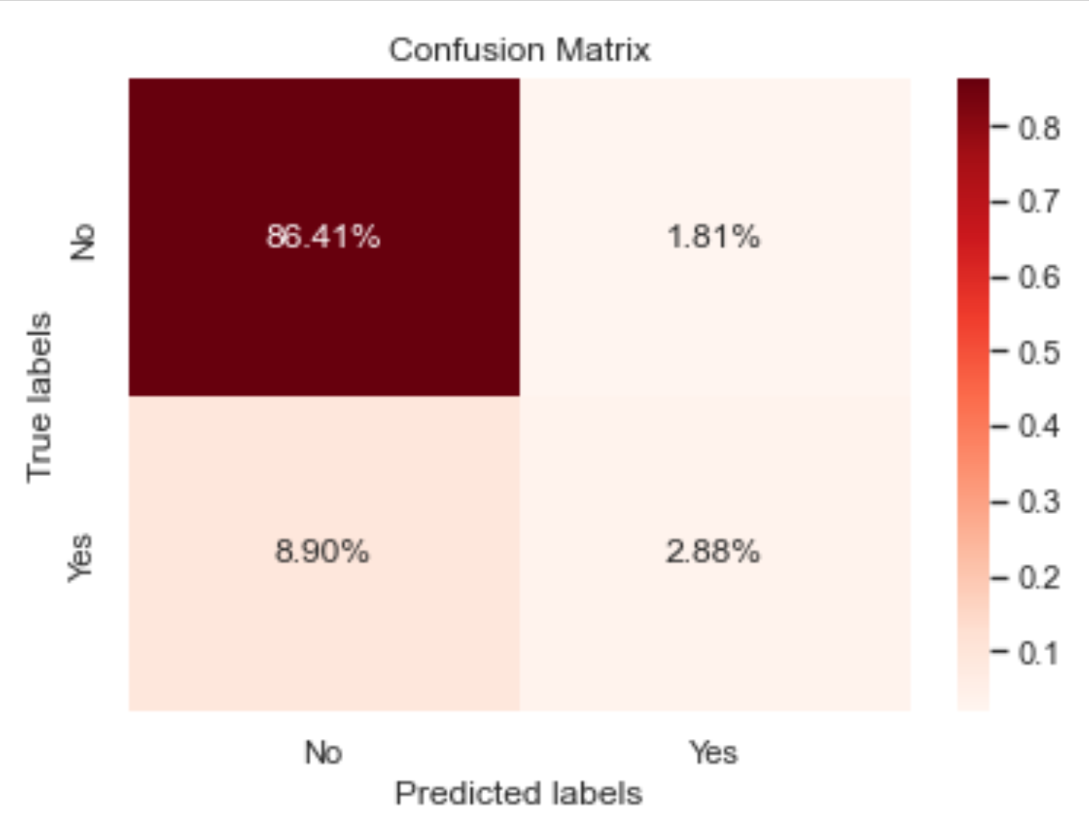
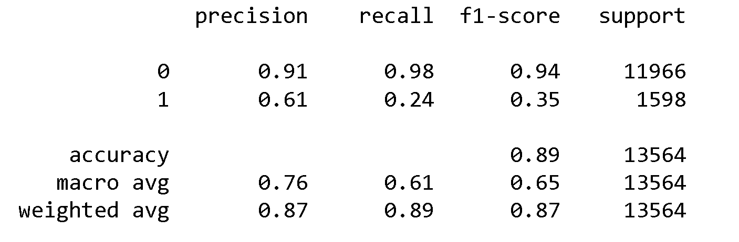
Random Forest
There are very few false positives (predicted value was ‘Yes’, but actual value was ‘No’), but many false negatives (predicted value was ‘No’, when the actual value was ‘Yes’). The model was very accurate at predicting ‘No’, but performed poorly when it came to predicting ‘Yes’.

Slide 18
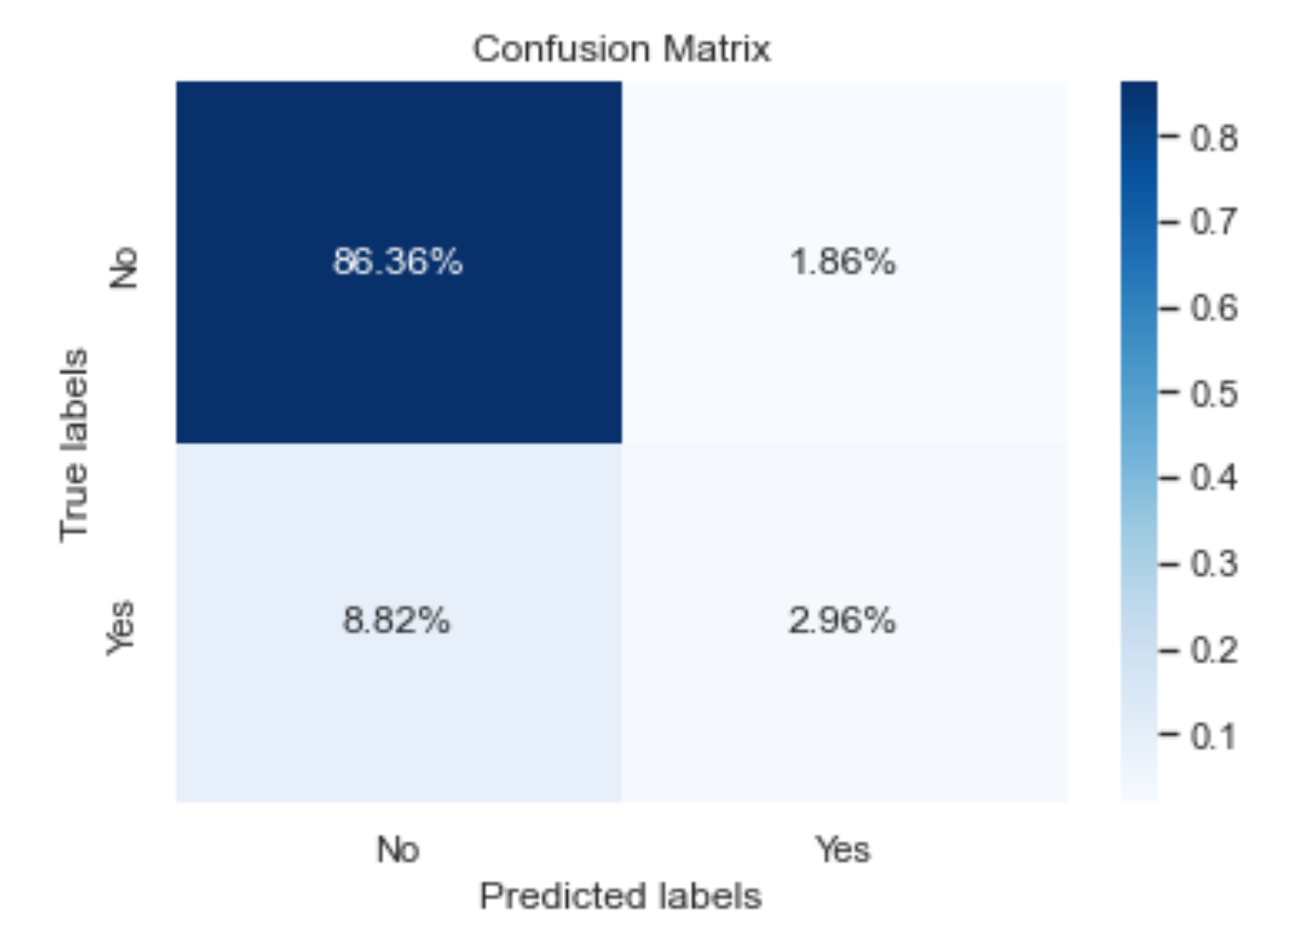
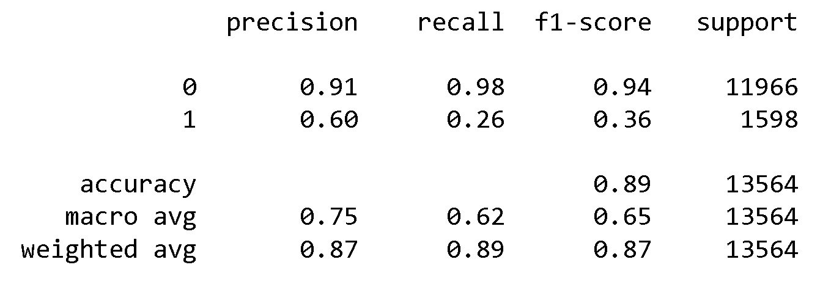
Artificial Neural Network
There are very few false positives (predicted value was ‘Yes’, but actual value was ‘No’), but many false negatives (predicted value was ‘No’, when the actual value was ‘Yes’). The model was very accurate at predicting ‘No’, but performed poorly when it came to predicting ‘Yes’.

Slide 19
Model Evaluation: Selecting the Best Model
All 3 of the models had roughly the same accuracy of 89%. The Artificial Neural Network was slightly better at predicting ‘Yes’ than the other models, but all 3 models had very similar precision, recall, and overall accuracy. We can use any of the 3 models to predict whether a client will subscribe for a term deposit. We can also fine tune the models to achieve a greater accuracy.

Slide 20
Results
According to the results of the Logistic Regression Model, clients are more likely to subscribe for a term deposit if:
The outcome of the previous campaign was successful
It is the month of March, October, September, or December (from most likely to least likely)
They are contacted by cell phone
They are retired or a student
According to the results of the Logistic Regression Model, clients are less likely to subscribe for a term deposit if:
It is the month of January, November, August, or July (from least likely to most likely)
Method of contact is unknown
The outcome of the previous campaign was a failure or unknown
The client has a housing loan or personal loan

